Slide 1

Rainham Mark Education Trust
Welcome
Thank you for choosing RMGS
Please take a seat

Slide 2


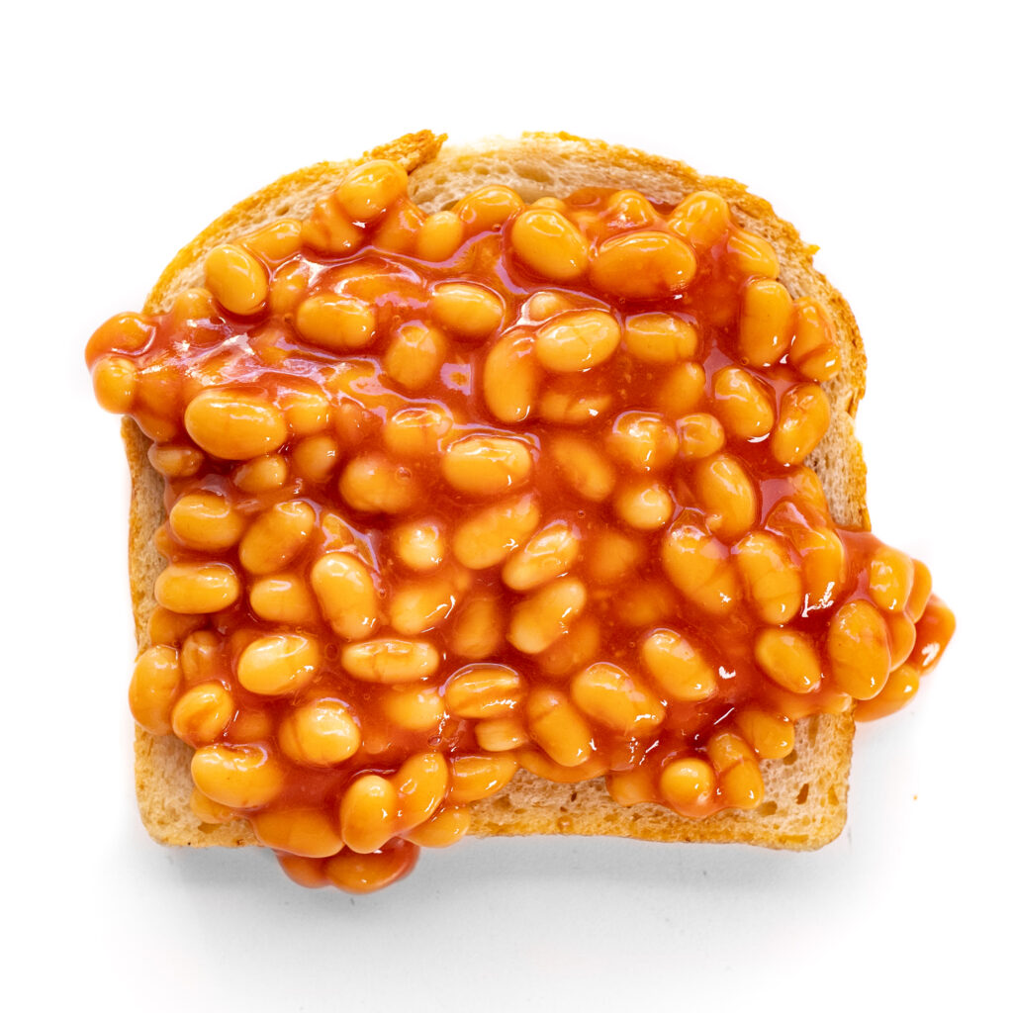
Welcome from Mrs Hart, Headteacher
Developing the whole person

Slide 3
Welcome from Mrs Hart, Headteacher
Our core purpose is to cultivate wisdom, character and strength in students so they can understand, celebrate and shape the world in which they live.

Slide 4


Welcome from Mrs Hart, Headteacher
P hilosophy
R eading
O racy
U nderstanding the world
D ebating

Slide 5
Who’s who?
Mrs C. Stewart – Pastoral Support Assistant for Year 7 parents and students
Form Tutors and Prefects
Mrs J Mayes – Head of Year 7
Mrs C Else – Inclusion Manager (DDSL)
Mrs K Robbins – Assistant Headteacher i/c KS3
Mr A Smith – Assistant Headteacher and SENCO i/c Behaviour & Inclusion (DDSL)
Mrs E Horstrup – Deputy Headteacher i/c Pastoral (DSL)

Slide 6
Welcome Our Year 7 Speakers
India
Tommy

Slide 7
Mrs Horstrup – Deputy Headteacher

Slide 8
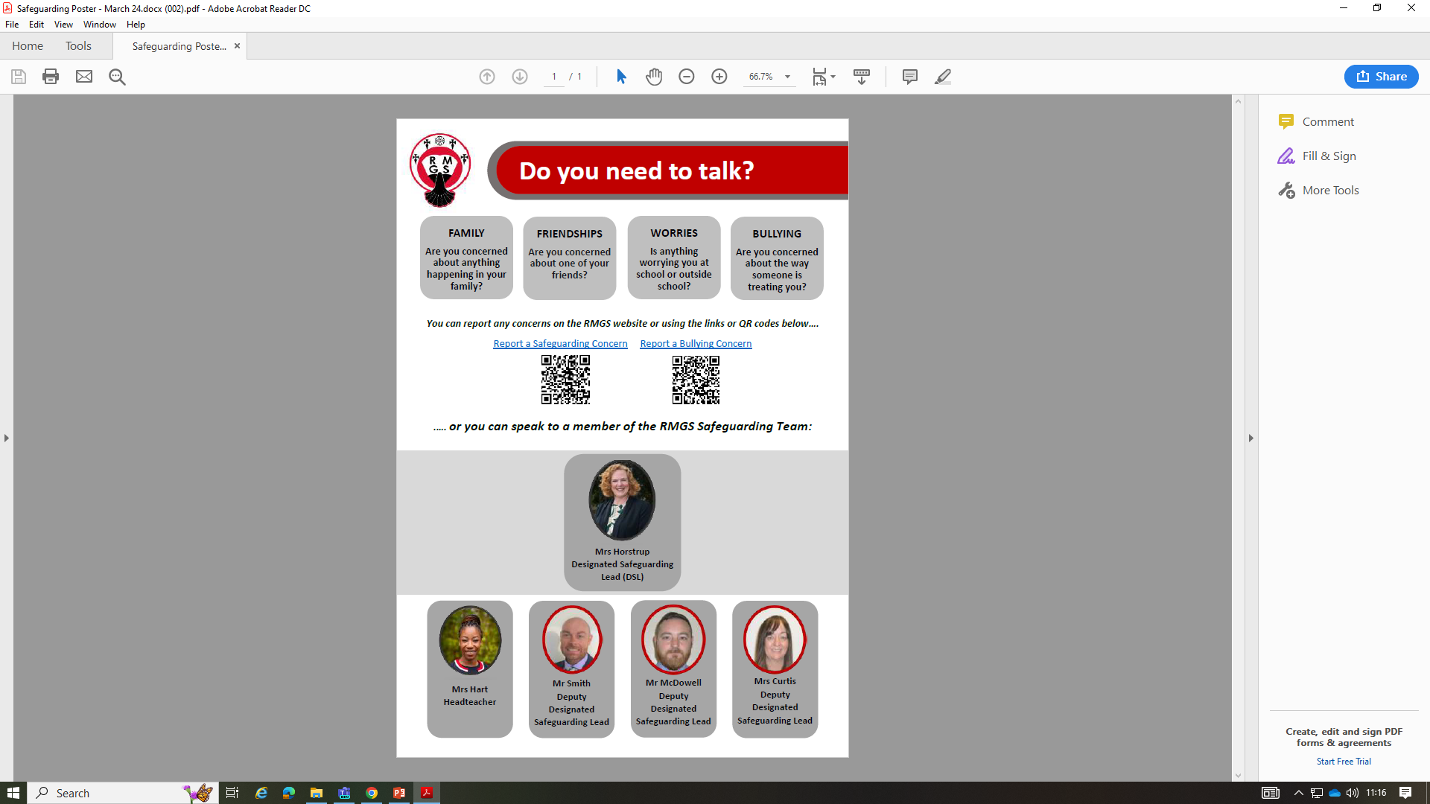
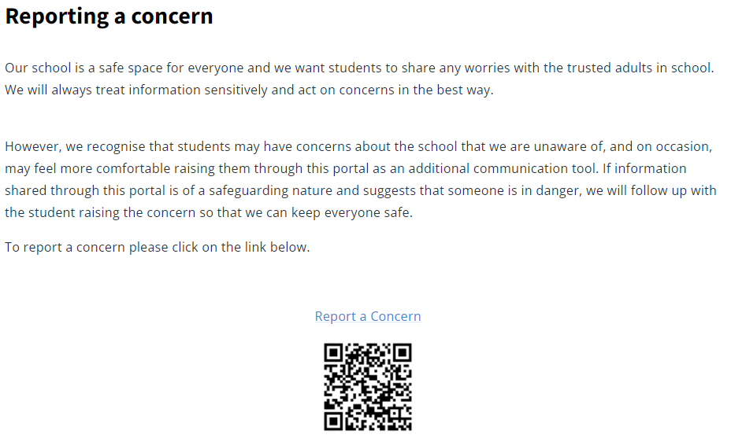
Safeguarding

Slide 9
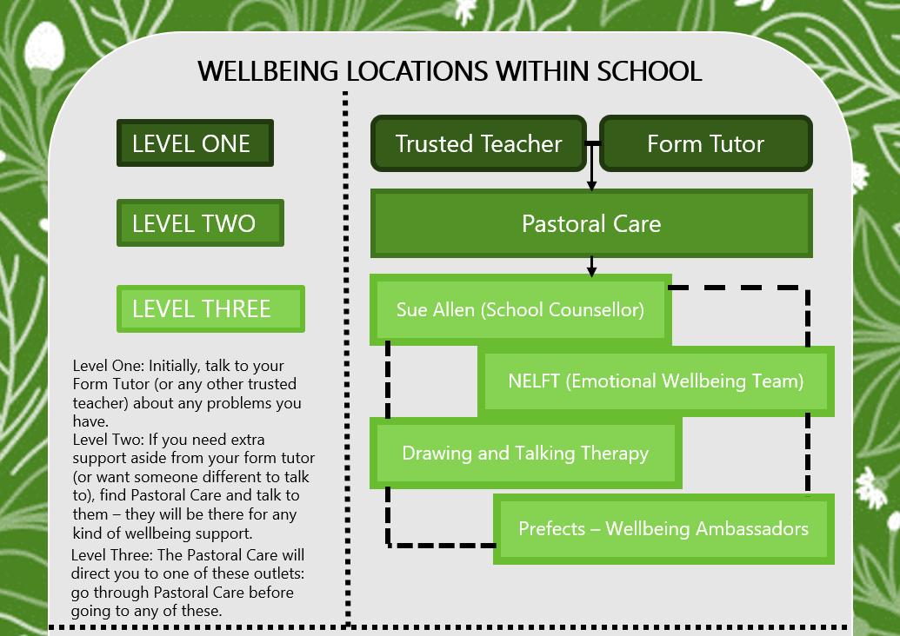

Slide 10
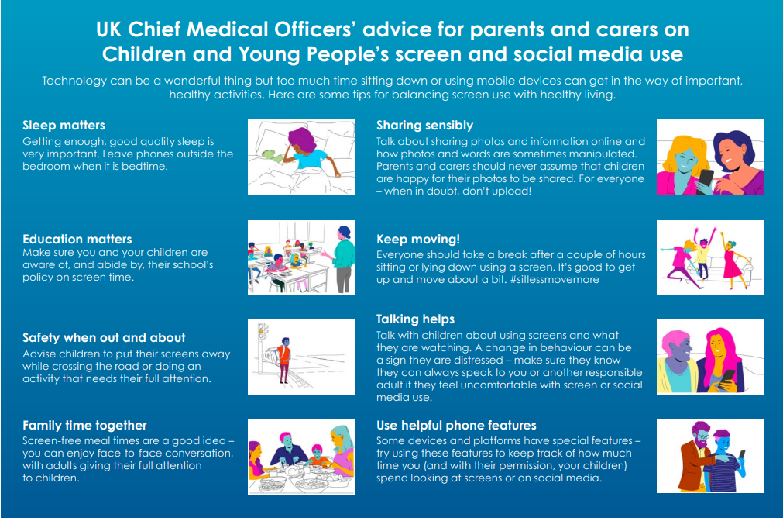

Slide 11


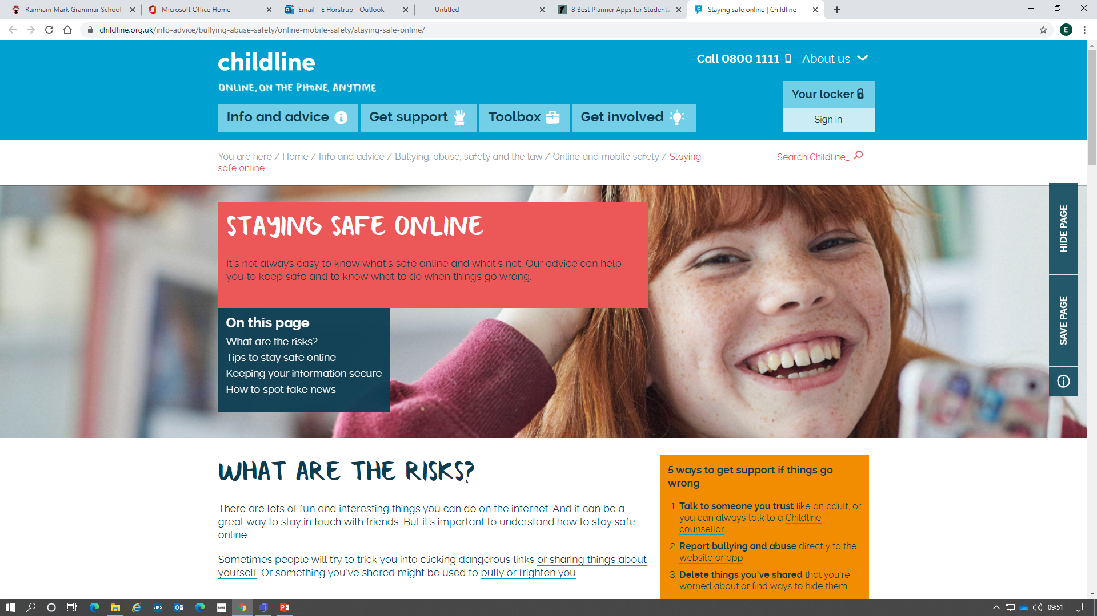
Staying Safe Online – filtering and monitoring

Slide 12

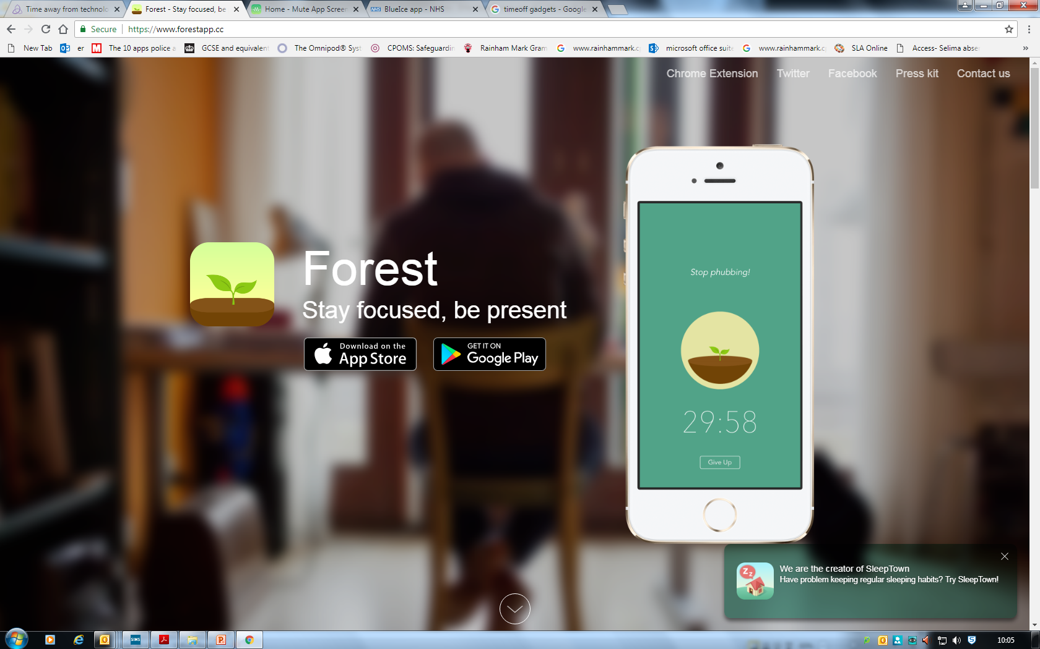
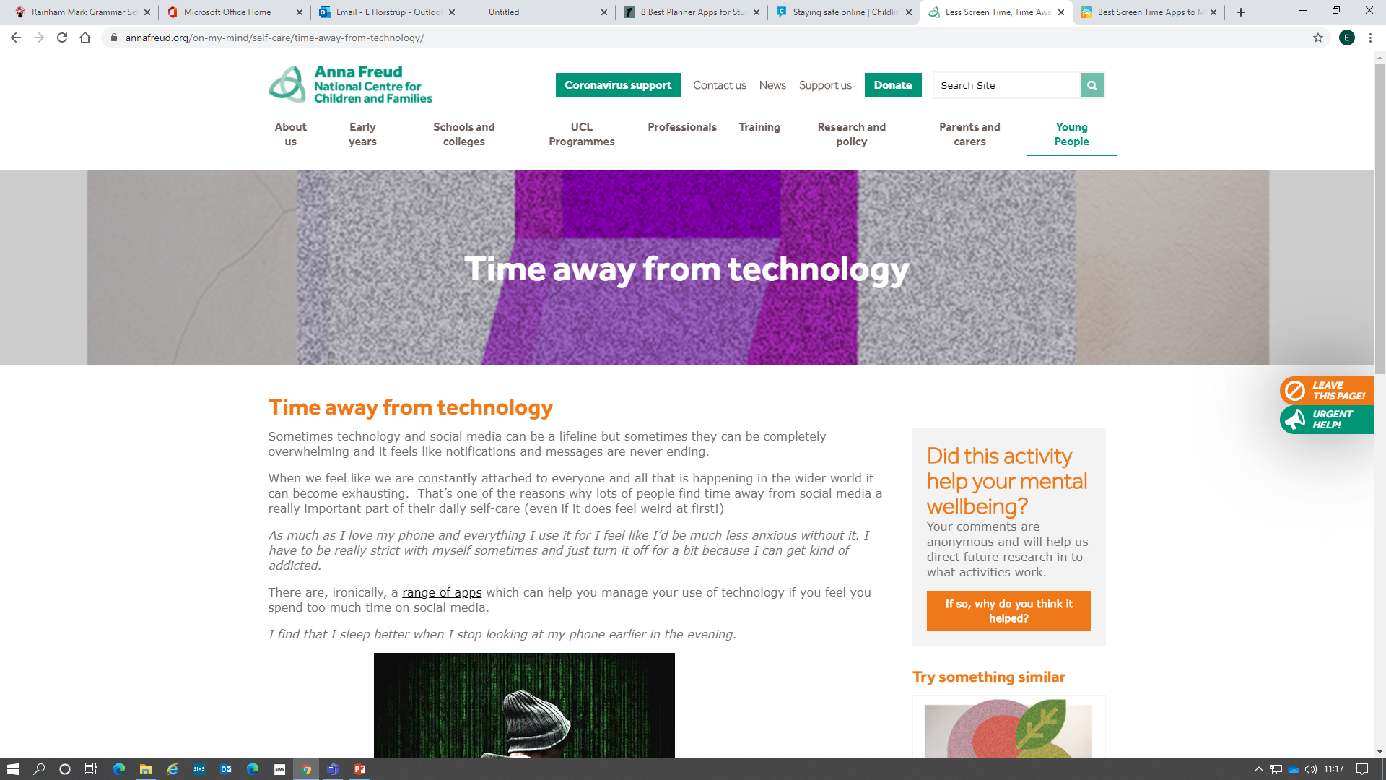
Taking back control – time off gadgets
OurPact is the number one Parental Control & Family Locator app that allows parents to set screen time management rules for their children's iOS or Android mobile devices and use safety tools to see their children's locations and gain insight into their device usage.

Slide 13
Mr Andy Smith – Assistant Headteacher
Rewards and Sanctions
Positive behaviours achieve Reward Points which contribute towards the House total and enable students to win prizes.
Negative behaviours result in sanctions and Consequence Points. These only count for the individual, not the House.
The following slides show our Ladder of Reward and Ladder of Consequence.
Our focus is on rewarding desired (good) behaviour.

Slide 14
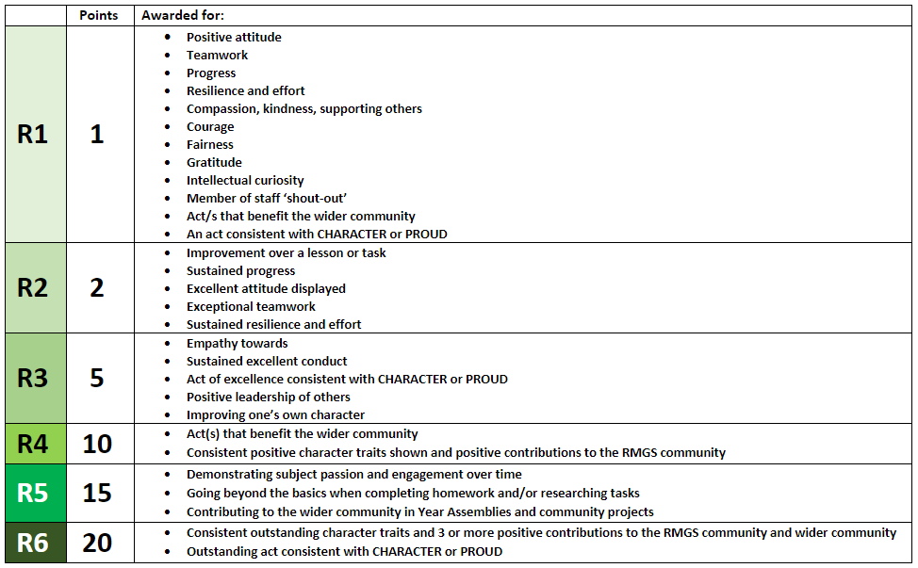
House Half Colours and Full Colours can be achieved across a variety of academic and character categories and are worth 25 and 50 points respectively.

Slide 15
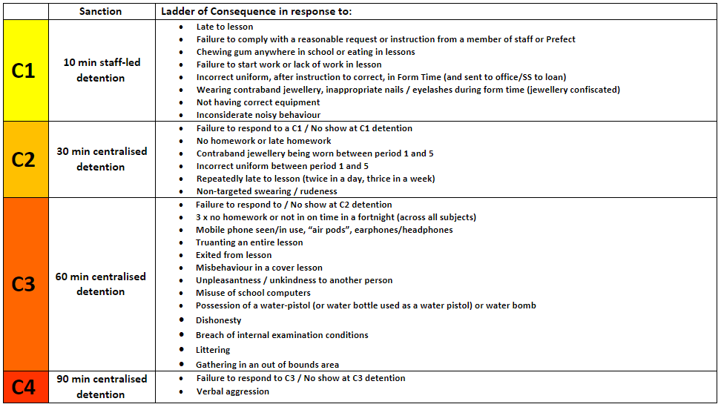

Slide 16
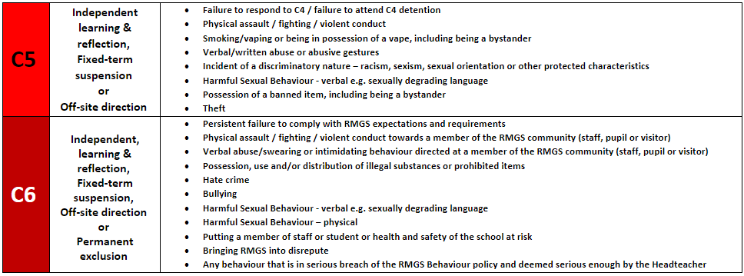

Slide 17
Pupil Premium Grant
Pupil Premium and Free School Meals at RMGS

Slide 18
What is the Pupil Premium?
The Pupil Premium is funding paid directly to schools, to support any children who receive Free School Meals (FSM)
At Rainham Mark Grammar School, we are committed to using the funding to the direct benefit of the children and families who receive FSM
We use Pupil Premium to support families with various costs, including:
  School uniform and P.E. Kits
  Stationery and revision guides
  School trips
  Instrument lessons
  £1.50 every day towards breakfast from the canteen

Slide 19
How do you apply for Pupil Premium?
For the school to receive Pupil Premium for your child, you would need to be eligible, and apply, for Free School Meals (FSM)
Families who receive certain benefits, including Universal Credit, Income Support, and Jobseeker’s Allowance, are eligible for FSM
You apply for Free School Meals from the Medway Council website: https://www.cloudforedu.org.uk/ofsm/medway/
There is also a link to this, and more details, on the RMGS website. Simply search “free school meals” in the search bar
As soon as your application is accepted, the school is informed, and we are able to give you the full support of the Pupil Premium

Slide 20
Mrs Mayes - Taster Day, Form Tutors, contact and extra-curricula clubs.
Taster Day is Thursday 4th July.
Arrive at 8:45 am and head to the Tennis Courts
Finish at 2:50 pm (pupils may wait for older siblings in the hall)
Lots of activities with their Form Tutors and Prefects
A taster lesson
A breaktime cookie and juice will be provided.
Lunch is provided (sausages, hash browns and peas/beans with vegan/gluten-free version available). Pupils will need their own water.
No need to bring any money as there is no where to spend it.
Can bring a packed lunch.
Bring plenty of water, more snacks (no nuts) if hungry, bag and a pen/pencil

Slide 21
A7 (Aylward) Mr C O’Neill | N7 (Newton) Mr R Wilkinson
B7 (Bronte) Miss H Mee | P7 (Pankhurst) Mr A Lorentson
F7 (Faraday) Mr Z Phillips | R7 (Rutherford) Miss P Barry
L7 (Lovelace) Mr A Staiano | S7 (Scott) Mr H Barty

Slide 22
Communication
Your Pastoral Assistant via a call to main office or pastoralsupportyear7@rmet.org. They can triage your request or enquiry quickly as non-teaching members of staff.
You can contact your child’s form tutor via email too (will be provided to the children in September).
You will be able to track your child’s reward and consequence points, and homework via the EduLink app.

Slide 23
Our extra-curricula programme - Developing the whole person
Drama and Music Productions | Sports Teams and Clubs – Basketball, Netball, Football, Dance, Rounders, Golf and Athletics.
Philosophy Club | Science Club
Dungeons & Dragons Club | Quantum Physics Club
Film Club | Big Band, Brass Group, Trombone Choir, Ukulele Club, String Ensemble, Junior Wind Band, Music Tech Club, Guitar Club, Vocal Chords.
Eco Club
Engineering Club | Design & Technology Club
Chess Club | Computing Club
Duke of Edinburgh | Young Enterprise

Slide 24
Meet Your Child’s Form Tutor
Mr C O’Neill A7 | F3
Miss Mee B7 | Hall
Mr Z Phillips F7 | A2
Mr Staiano L7 | Library

Slide 25
Meet Your Child’s Form Tutor
Mr Wilkinson N7 | F3
Mrs Mayes (for Mr Lorentson) P7 | A2
Miss Barry R7 | Hall
Mr Barty S7 | Library

Slide 26

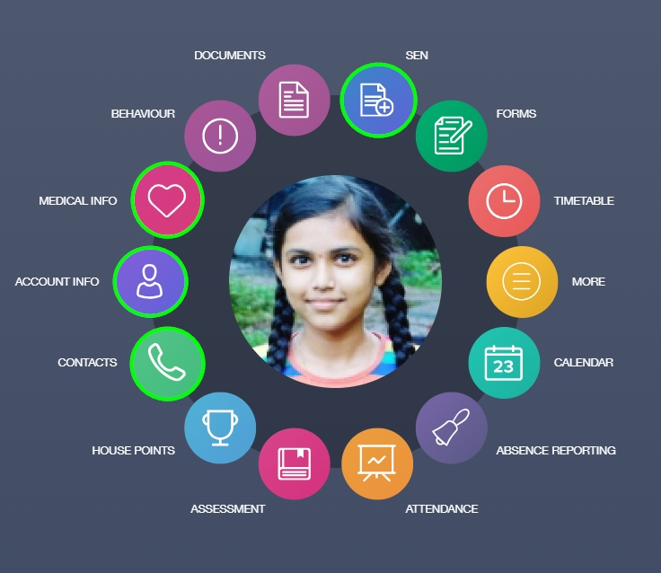
Our School Day
8:30 am to 3:05 pm. Breakfast club from 8:00 am in the Hall.
8:35 – 8:55 Registration and form time / assembly (Monday for Year 7)
8:55 – 9:55 Period 1
9:55 – 10:55 Period 2
10:55 – 11:20 Break
11:20 – 12:20 Period 3
12:20 – 13:20 Period 4
13:20 – 14:05 Lunch
14:05 – 15:05 Period 5

Slide 27
The RMGS way.
Uniform
  Black blazer with school badge and tutor group flash
  Black trousers (not skinny fit), white shirt (not polo shirt) and official school / colours tie
  OR
  Mid/dark grey pleated skirt, worn to the knee, with white revere collar blouse or white shirt and tie
  Black, white or dark grey socks with trousers, black, white or dark grey ankle or knee high socks or black opaque tights with skirts
  Black leather/leather-look shoes (no boots, trainers, sandals or plimsolls)
  Lanyard in the correct colour for Year Group
  Optional RMGS V-necked jumper (grey for Years 7-9, black for Years 10 and 11). No sweatshirts, designer label pullovers, or hoodies. Jumpers must not be worn in place of a blazer.
  See SchoolTime and Rainham Sports stand in the hall.

Slide 28
The RMGS way
PE Kit
  Red T-shirt with RMGS logo
  Red ¼ zip jumper with RMGS logo
  Plain black shorts (mid-thigh or longer, but no cycling shorts)/leggings/tracksuit bottoms/skirt
  White short socks
  Plain black football socks
  Football boots and shin pads (purchase when advised by PE staff)
  Trainers (non-marking soles)
  PE bag
  Optional: Plain black thermal base layer, a towel, white plimsolls for gym/dance in event of foot infection (otherwise barefoot)
  See SchoolTime and Rainham Sports stand in the hall.

Slide 29
The RMGS way
Acceptable appearance
  One small ear stud (no rings)
  One small nose stud (no rings)
  A watch (smart watches must be removed in examinations)
  Religious headwear in keeping with school colours
  Religious or cultural jewellery (as agreed with the school)
  Hair worn appropriately for school activities
  Natural nails
  Natural-looking eyelashes
  Discreet make-up
All jewellery must be removed for PE
Outdoor coats, hats, scarves and gloves maybe of any colour, but may only be worn outside of the buildings

Slide 30
The RMGS way
Equipment
  Pencil case, black pen(s), green pen, pencil, rubber, ruler
  Calculator, basic geometry set
  Coloured pencils and glue-stick are useful
  Reading book and school planner
  Strong school bag (any colour), not a handbag or drawstring bag (except for PE kit)
Planner and how to use
  Homework should be written down every day. Please check your child’s planner and help them to get organised for the next day. Parents can check all homework via the Edulink app.
Travel
  Encourage your child to walk, cycle, use the bus so that they become more independent. It is a good opportunity to catch up with friends.

Slide 31
The RMGS way
Mobile phone policy
  Not allowed to be used once inside the school gates. Should be turned off and kept in bag/blazer pocket.
Medicines
  Can be left in the office but must be named.
Rewards and Sanctions (House Points) – it’s ok to make a mistake!
Homework Club
  Every day from 3:05pm to 4:05pm. Optional, no booking just turn up.
Food at RMGS – how to pay
  Lots of choice and students will be given a lanyard and a card that can be charged up with money so they can purchase food. We do not have cash facilities on site.
Extra Curricular Activities
  Lots of clubs. Encourage your child to join in and to make new friends. Clubs will be advertised around school and in assemblies.

Slide 32
Organisation
Students can master it!
Parents and carers can really support here.
Encourage your children to...
  Use their planners
  Get homework out of the way, early. Check it on Edulink.
  Get into a routine of packing their bag early in the evening and then relaxing

Slide 33

Ensuring the basics are in place
Talk about your own systems you use in your home / working lives.
Student planner has a “remember section” and a ‘due date’
Build in review and reflection:
  ‘How long did this piece of homework take?’
  ‘Why was this the most difficult?’
  ‘Was there anything else on your mind when you were completing this piece of homework?’.
Routine of packing bag and then relaxing.

Slide 34
Any Questions
Please note: the next session starts at 18:30 so to avoid a jam, please leave by 18:10 at the latest. Thanks so much.

