Slide 1

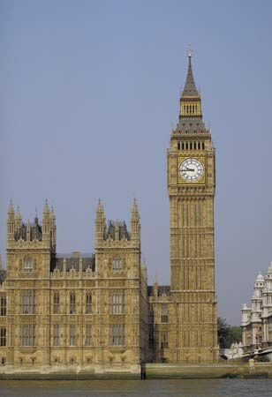
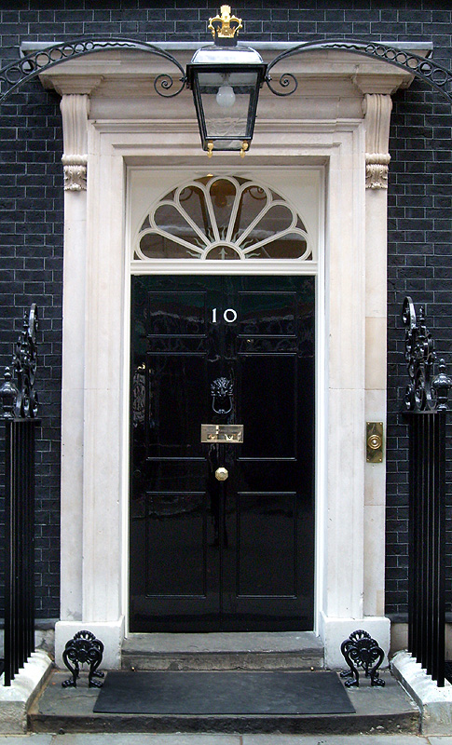
A Level Politics
Induction Booklet
Mrs Rowden-Knowles and Mr Brown
srowden-knowles@rmgs.org.uk
mbrown@rmgs.org.uk

Slide 2
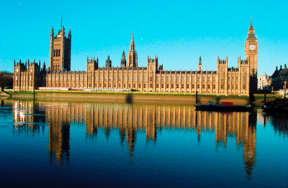
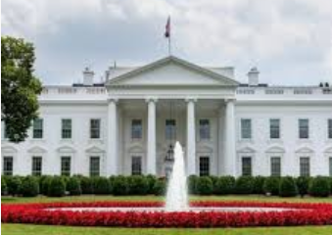
Welcome to A Level Politics
The next two terms give you an amazing opportunity to develop your political knowledge – we are sure you will be engrossed in the subject!
This programme of study has been designed especially to prepare you for the course, with an overview of each of the key topics on UK Politics, which we cover during Year 12.
A Level Politics course
aims to provide you with a balanced education in politics, an understanding of the nature of politics, and an understanding in the context of the Untied Kingdom, including its local, national and European dimensions, and some aspects of comparative study of the USA system.
In preparation for the start of your A Level Politics’ lessons in September, we would like you to become engaged with the world of Politics by completing the Induction Programme of Study, which starts on Slide 5.
BRONZE AWARD: Part One Activities 1 – 5
SILVER AWARD: Part One Activities 6 - 10
GOLD AWARD: Part Two Current Affairs Diary
If you have any problems, or would like to ask us any questions, please email us:
Mrs Rowden-Knowles: srowden-knowles@rmgs.org.uk
Mr Brown: mbrown@rmgs.org.uk

Slide 3
WHAT DOES THE COURSE INVOLVE?
Term | Topics Covered | Exam
Year 12:
Autumn Term | UK Politics Democracy and participation Political parties Electoral system Voting behaviour and the media | A level: 2 hours to also include Core political ideas.
Spring Term | UK Government The constitution Parliament Prime Minister and executive Relationships between the branches | A Level: 2 hours to also include Non-Core political ideas.
Summer Term | Core political ideas: Conservatism Liberalism Socialism Non-Core political ideas: Anarchism | A level: 2 exam papers 2 hours each to cover UK politics (including Core political ideas) and UK Government (including non-Core political ideas)
Year 13:
Autumn Term | American Politics: US Constitution and federalism US Congress US Presidency US Supreme Court and civil rights US democracy and participation Similarities and difference sin the UK and US. | A Level: 1 exam paper on Comparative American Politics 2 hours
Spring Term

Slide 4

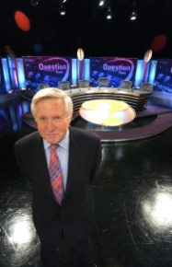





HOW WILL YOU BE SUCCESSFUL IN A LEVEL POLITICS?
YOU WILL NEED TO TAKE AN INTEREST IN CURRENT AFFAIRS AND POLITICAL ISSUES
This will involve:
Reading a QUALITY newspaper (such as The Times, Guardian, Telegraph, Independent or their Sunday equivalent;
magazines and specific politics journals such as Politics Review as well as the set textbooks.
Watching current affairs programmes such as Panorama, Despatches etc. and specific politics programmes such as ' A Week in Politics‘.
Watching the news or listening to 'Today' on Radio 4.
Discussing and debating political issues with both fellow politics students and others
Keeping a scrap book of press cuttings on politics and issues
You will have to read widely and work hard to understand:
The institutions and main features of the British system of government and British politics.
How these work in theory and practice
The way they interact their strengths and weaknesses
The way they may change

Slide 5
Politics Induction Programme of Study
PART ONE:
Complete the following activities. You will need to start with the booklet ‘Parliament Find Your Way’. It is saved as a pdf.
Read the relevant pages in this booklet and then complete the following tasks.
This will give you a brilliant introduction to the fundamentals of the British political system!
1. The History of Parliament (Bronze)
Read page 4-5 in the booklet.
Visit https://www.youtube.com/watch?v=lRLRhDB-HxE
Create a timeline to illustrate the ‘Journey to Democracy’.
2. Democracy (Bronze)
Read page 6-7 in the booklet.
Write a definition for the following words:
  Democracy
  Representative democracy
  Direct Democracy
  Politics
  Dictatorship
  Suffrage
  Franchise
Watch ‘Democracy? You Decide’: https://www.youtube.com/watch?v=LX1Ul0oX9DY
Answer the following questions:
  What would the UK be like if we didn’t live in a democracy?
  What are the strengths and weaknesses of the UK system of democracy?
  What other options are there and where are they in place right now?

Slide 6
3. The Constitution (Bronze)
Read page 8-9 in the booklet.
Write a definition of the following words:
  Constitution
  Uncodified constitution
  Codified constitution
  Parliamentary sovereignty
  Devolution
  The Human Rights Act
  The European Union
  The UK Supreme Court
4. The constitution: The EU (Bronze)
Read page 10-11 in the booklet.
Create a timeline of the major dates and events of the UK’s relationship with the European Union, from joining back in 1973 up to the present day.

Slide 7
5. Parliament (Bronze)
Read page 12-17 in the booklet.
Write a definition of the following words:
  Bicameral legislature
  House of Commons
  House of Lords
  Monarch
  Legislation
  Scrutiny
  Representation
  Two-House system
  Bills
  The Queen’s Speech
  Select Committees
  General Committees
  Public Bills Committee
  Grand Committees
  Liaison Committee
  Prime Minister's Questions
  Ministerial Questions
What role does the monarch have in our Parliament?
What is the benefit of a two-House system?
What is the key role of the committees?
What is the main different between the House of Commons and the House of Lords?
Who do MPs represent?
What is the difference between the Executive and the Legislature?
How in the UK system of government do these over-lap? (Clue: this is called Fusion of Power)
What is the major problem with the House of Lords in terms of democracy?
What are the pros and cons of having an unelected second chamber?
Who would you nominate as a Life Peer and why?
High Court Judges also used to sit in the House of Lords: where do they now sit? Why do you think it was important to separate them from the work of the House of Lords?
Constituents
MPs
Government Minister
Backbencher
The Executive
Government
Opposition
Cabinet
Speaker
The Legislature
Crossbenchers
Lord Speaker
House of Lords Act 1999
Hereditary Peers
Life Peers
Peers Spiritual

Slide 8
6. Legislation: Making New Laws (Silver)
Read page 12-17 in the booklet.
Write a definition of the following words:
  Public Bills
  Government Bills
  Private Members Bills
  Manifesto
  Amendments
  Division
  Filibuster
  Free Vote
  Green Paper
  Motion
  Ping-Pong
  Tellers
  Wash-up
  White Paper
Play the following game: https://learning.parliament.uk/resources/mp-for-a-week/
Answer the following questions:
  What one law would you make and why?
  How would you enforce the law?
  What implications might it have for communities in the UK?

Slide 9
7. Elections and Voting (Silver)
Read page 20-21 in the booklet.
Write a definition for the following words:
  General election
  Devolved Assembly/ Parliament elections
  European elections
  Local elections
  By-elections
  Referendums
Read through the different types of voting systems on page 21. Which do you think would be the best system for the UK to adopt for General Elections and why?
In 2011 there was a referendum on introducing AV. Research the outcome of this referendum. Why do you think this outcome occurred?
8. Elections and Voting: Trends and Types (Silver)
Read page 22-23 in the booklet.
Write a definition for the following words:
  Voter Turnout
  Polling Day
  Compulsory Voting
  Separation of Powers
  Proportional Representation
Why do you think voter turnout is low in Britain?
Should the UK make voting compulsory? What are the arguments for and against?
Should the voting age be lowered to 16? What are the arguments for and against?
You will soon be old enough to vote – how do you register to vote?
Go to https://www.parliament.uk/get-involved/elections/referendums-held-in-the-uk/ and research another referendum that has happened in the UK. (Do not select the AV Vote or the EU referendum)
What was the topic of the referendum? What was the turnout? What was the
outcome?

Slide 10
9. Political Parties (Silver)
Read page 24-25 in the booklet.
Write a definition for the following words/topics:
  Political Party
  Coalition government
  Majority
  Functions of political parties
  Party Whips
  Party Rebels
  ‘withdrawing the whip’
Which political party currently governs this country?
How many seats (or MPs) do the three main parties each have in the House of Commons?
Research the main political position of the three main political parties in the following areas:
  Immigration
  Taxes and the Economy
  The NHS
  Security, defence and foreign affairs
  Jobs
  Education
  Law and Order
  Benefits/ Poverty
Who would you vote for and why?
10. Pressure Groups (Silver)
Read page 26-27 in the booklet.
Write a definition for the following words/topics:
  Pressure Group
  Lobbying
  Petitions
  Popular protest
  Celebrity endorsement
  Direct Action.
How is a pressure group different from a political party?
Research one pressure group – why is its aim? Who does it represent? What methods has it used to try to get its message across? How successful has it been?

Slide 11
PART TWO:
Current Affairs Diary
(GOLD)
Start your current affairs diary in the summer holidays. You will continue to keep this diary throughout your time studying politics in the sixth form.
How to keep a current affairs diary:
Each morning, listen to, watch or read what is going on in the country and make a list of the top three news stories. Look at one of the internet news sites and/or spending some time each day in the school library or at home looking at a newspaper.
In your diary make a list of the top three stories, including a brief outline of what has happened.
At the end of each week you must select one of these stories and write a short editorial on it. This should include:
  An objective explanation of the issue. How it has progressed across the week.
  Opinions from different viewpoints.
  Your opinion – including where applicable alternative solutions to the problem or issue being criticised.
What you need to bring with you in September:
Your completed work on all the sections.
Your up-to-date current affairs diary
A lever-arch folder set up with dividers to cover all the units you will be studying.
We very much look forward to meeting you all in September.!
Mrs Rowden-Knowles and Mr Brown

