Slide 1
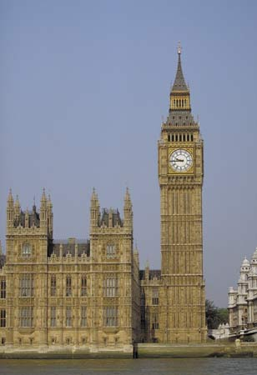
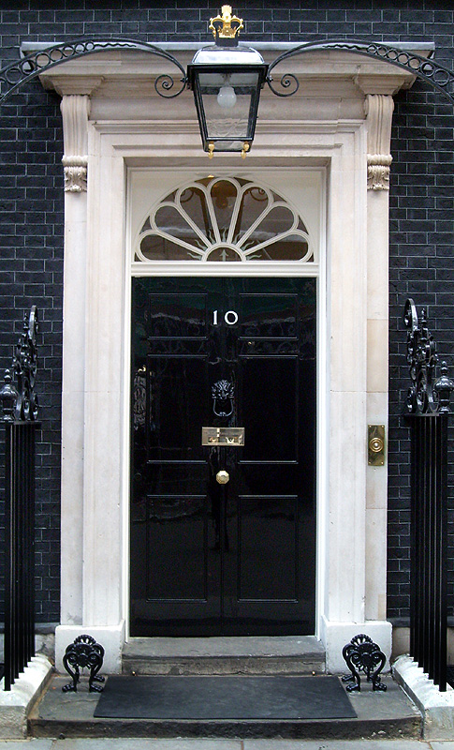
A Level Politics
Induction Booklet
Mrs Rowden-Knowles and Mr Brown
srowden-knowles@rmgs.org.uk
mbrown@rmgs.org.uk

Slide 2
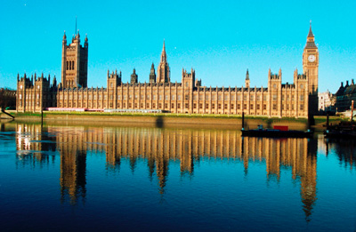
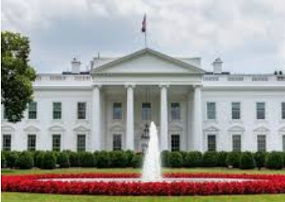
Welcome to A Level Politics
The next two terms give you an amazing opportunity to develop your political knowledge – we are sure you will be engrossed in the subject!
This programme of study has been designed especially to prepare you for the course, with an overview of each of the key topics on UK Politics, which we cover during Year 12.
A Level Politics course
aims to provide you with a balanced education in politics, an understanding of the nature of politics, and an understanding in the context of the Untied Kingdom, including its local, national and European dimensions, and some aspects of comparative study of the USA system.
In preparation for the start of your A Level Politics’ lessons in September, we would like you to become engaged with the world of Politics by completing the Induction Programme of Study, which starts on Slide 5.
BRONZE AWARD: Part One Activities 1 – 5
SILVER AWARD: Part One Activities 6
GOLD AWARD: Part Two Current Affairs Diary
If you have any problems, or would like to ask us any questions, please email us:
Mrs Rowden-Knowles: srowden-knowles@rmgs.org.uk
Mr Brown: mbrown@rmgs.org.uk

Slide 3
WHAT DOES THE COURSE INVOLVE?
Term | Topics Covered | Exam
Year 12:
Autumn Term | UK Politics Democracy and participation Political parties Electoral system Voting behaviour and the media | A level: 2 hours to also include Core political ideas.
Spring Term | UK Government The constitution Parliament Prime Minister and executive Relationships between the branches | A Level: 2 hours to also include Non-Core political ideas.
Summer Term | Core political ideas: Conservatism Liberalism Socialism Non-Core political ideas: Anarchism | A level: 2 exam papers 2 hours each to cover UK politics (including Core political ideas) and UK Government (including non-Core political ideas)
Year 13:
Autumn Term | American Politics: US Constitution and federalism US Congress US Presidency US Supreme Court and civil rights US democracy and participation Similarities and difference sin the UK and US. | A Level: 1 exam paper on Comparative American Politics 2 hours
Spring Term

Slide 4
HOW WILL YOU BE SUCCESSFUL IN A LEVEL POLITICS?
YOU WILL NEED TO TAKE AN INTEREST IN CURRENT AFFAIRS AND POLITICAL ISSUES
This will involve:
Reading a QUALITY newspaper (such as The Times, Guardian, Telegraph, Independent or their Sunday equivalent;
magazines and specific politics journals such as Politics Review as well as the set textbooks.
Watching current affairs programmes such as Panorama, Despatches etc. and specific politics programmes such as ' A Week in Politics‘.
Watching the news or listening to 'Today' on Radio 4.
Discussing and debating political issues with both fellow politics students and others
Keeping a scrap book of press cuttings on politics and issues
You will have to read widely and work hard to understand:
The institutions and main features of the British system of government and British politics.
How these work in theory and practice
The way they interact their strengths and weaknesses
The way they may change

Slide 5
Politics Induction Programme of Study
PART ONE:
Complete the following activities. You will need to start with the booklet ‘Parliament Find Your Way’. It is saved as a pdf.
Read the relevant pages in this booklet and then complete the following tasks.
This will give you a brilliant introduction to the fundamentals of the British political system!
1. The History of Parliament (Bronze)
Read page 4-5 in the booklet.
Visit https://www.youtube.com/watch?v=lRLRhDB-HxE
Create a timeline to illustrate the ‘Journey to Democracy’.
2. Democracy (Bronze)
Read page 6-7 in the booklet.
Write a definition for the following words:
Democracy
Representative democracy
Direct Democracy
Politics
Dictatorship
Suffrage
Franchise
Watch ‘Democracy? You Decide’: https://www.youtube.com/watch?v=LX1Ul0oX9DY
Answer the following questions:
What would the UK be like if we didn’t live in a democracy?
What are the strengths and weaknesses of the UK system of democracy?
What other options are there and where are they in place right now?

Slide 6
3. The Constitution (Bronze)
Read page 8-9 in the booklet.
Write a definition of the following words:
Constitution
Uncodified constitution
Codified constitution
Parliamentary sovereignty
Devolution
The Human Rights Act
The European Union
The UK Supreme Court
4. The constitution: The EU (Bronze)
Read page 10-11 in the booklet.
Create a timeline of the major dates and events of the UK’s relationship with the European Union, from joining back in 1973 up to the present day.

Slide 7
5. Parliament (Bronze)
Read page 12-17 in the booklet.
Write a definition of the following words:
Bicameral legislature
House of Commons
House of Lords
Monarch
Legislation
Scrutiny
Representation
Two-House system
Bills
The Queen’s Speech
Select Committees
General Committees
Public Bills Committee
Grand Committees
Liaison Committee
Prime Minister's Questions
Ministerial Questions
What role does the monarch have in our Parliament?
What is the benefit of a two-House system?
What is the key role of the committees?
What is the main different between the House of Commons and the House of Lords?
Who do MPs represent?
What is the difference between the Executive and the Legislature?
How in the UK system of government do these over-lap? (Clue: this is called Fusion of Power)
What is the major problem with the House of Lords in terms of democracy?
What are the pros and cons of having an unelected second chamber?
Who would you nominate as a Life Peer and why?
High Court Judges also used to sit in the House of Lords: where do they now sit? Why do you think it was important to separate them from the work of the House of Lords?
Constituents
MPs
Government Minister
Backbencher
The Executive
Government
Opposition
Cabinet
Speaker
The Legislature
Crossbenchers
Lord Speaker
House of Lords Act 1999
Hereditary Peers
Life Peers
Peers Spiritual

Slide 8
6. Legislation: Making New Laws (Silver)
Read page 12-17 in the booklet.
Write a definition of the following words:
Public Bills
Government Bills
Private Members Bills
Manifesto
Amendments
Division
Filibuster
Free Vote
Green Paper
Motion
Ping-Pong
Tellers
Wash-up
White Paper
Play the following game: https://learning.parliament.uk/resources/mp-for-a-week/
Answer the following questions:
What one law would you make and why?
How would you enforce the law?
What implications might it have for communities in the UK?

Slide 9
PART TWO: Current Affairs Diary (GOLD)
Start your current affairs diary in the summer holidays. You will continue to keep this diary throughout your time studying politics in the sixth form.
How to keep a current affairs diary:
Each morning, listen to, watch or read what is going on in the country and make a list of the top three news stories. Look at one of the internet news sites and/or spending some time each day in the school library or at home looking at a newspaper.
In your diary make a list of the top three stories, including a brief outline of what has happened.
At the end of each week you must select one of these stories and write a short editorial on it. This should include:
An objective explanation of the issue. How it has progressed across the week.
Opinions from different viewpoints.
Your opinion – including where applicable alternative solutions to the problem or issue being criticised.
What you need to bring with you in September:
Your completed work on all the sections.
Your up-to-date current affairs diary
A lever-arch folder set up with dividers to cover all the units you will be studying.
We very much look forward to meeting you all in September.!
Mrs Rowden-Knowles and Mr Brown

